Slide 1

Sindh Engro Coal Mining Company Thar Block II Open Pit Lignite Mine Power Sourcing Economic Modeling

Slide 2
Baseline Site, Load and Energy Data

Slide 3

Load Projection
The above load projection as well as hourly load data was combined to form hourly load projections over 12 years.

Slide 4
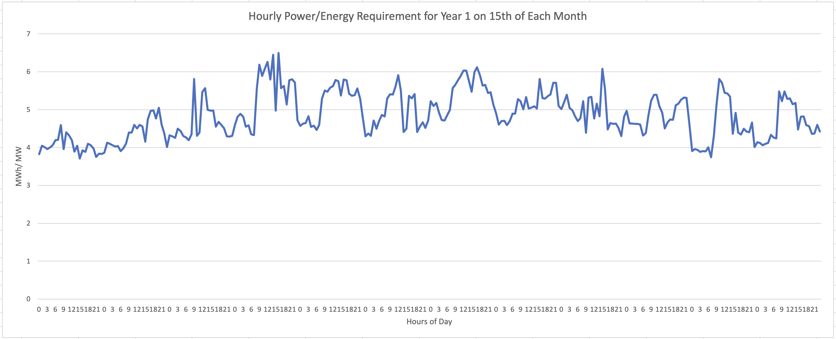
Hourly Energy Demand Projection
The first task of the model is to select sources that can meet the hourly energy demand.

Slide 5
Key Assumptions

Slide 6
Assumptions
Exchange Rate: 1 USD = 290
Loss amount: PKR 34,000,000 per hour of critical load interruption
Loss duration: any load interruptions due to power failures are considered to be only one hour long. This is because most load interruptions will be caused by lack of stability and inadequate spinning reserve in the system
Existing generator sets capital cost: PKR 45,000,000 per MW.
Above CAPEX is used to determine depreciation (straight-line, 10-year life)
Source probable failures and downtimes are defined as per experience source each source type (see Source Details)

Slide 7
Assumptions
BESS systems are used only to cater for source failures, reductions which create a sudden deficit in power. The model does not assume that they can be run as continuous power source for more than hour.
Thus, a BESS unit of 0.5MWh is considered to be able to provide 500kW power for one hour, before it needs to be charged.

Slide 8
Inflation Assumptions
Model incorporates different inflation levels for each source.
Solar and BESS sources have 5% inflation rate reflecting decreasing $/W cost due to technology improvements.
Steam Turbine source also has 5% inflation rate, as fuel is locally available at a subsidized cost.
Furnace oil and diesel fueled generator sources have a higher 7.5% inflation due to import dependence.

Slide 9
Details of Power Sources

Slide 10
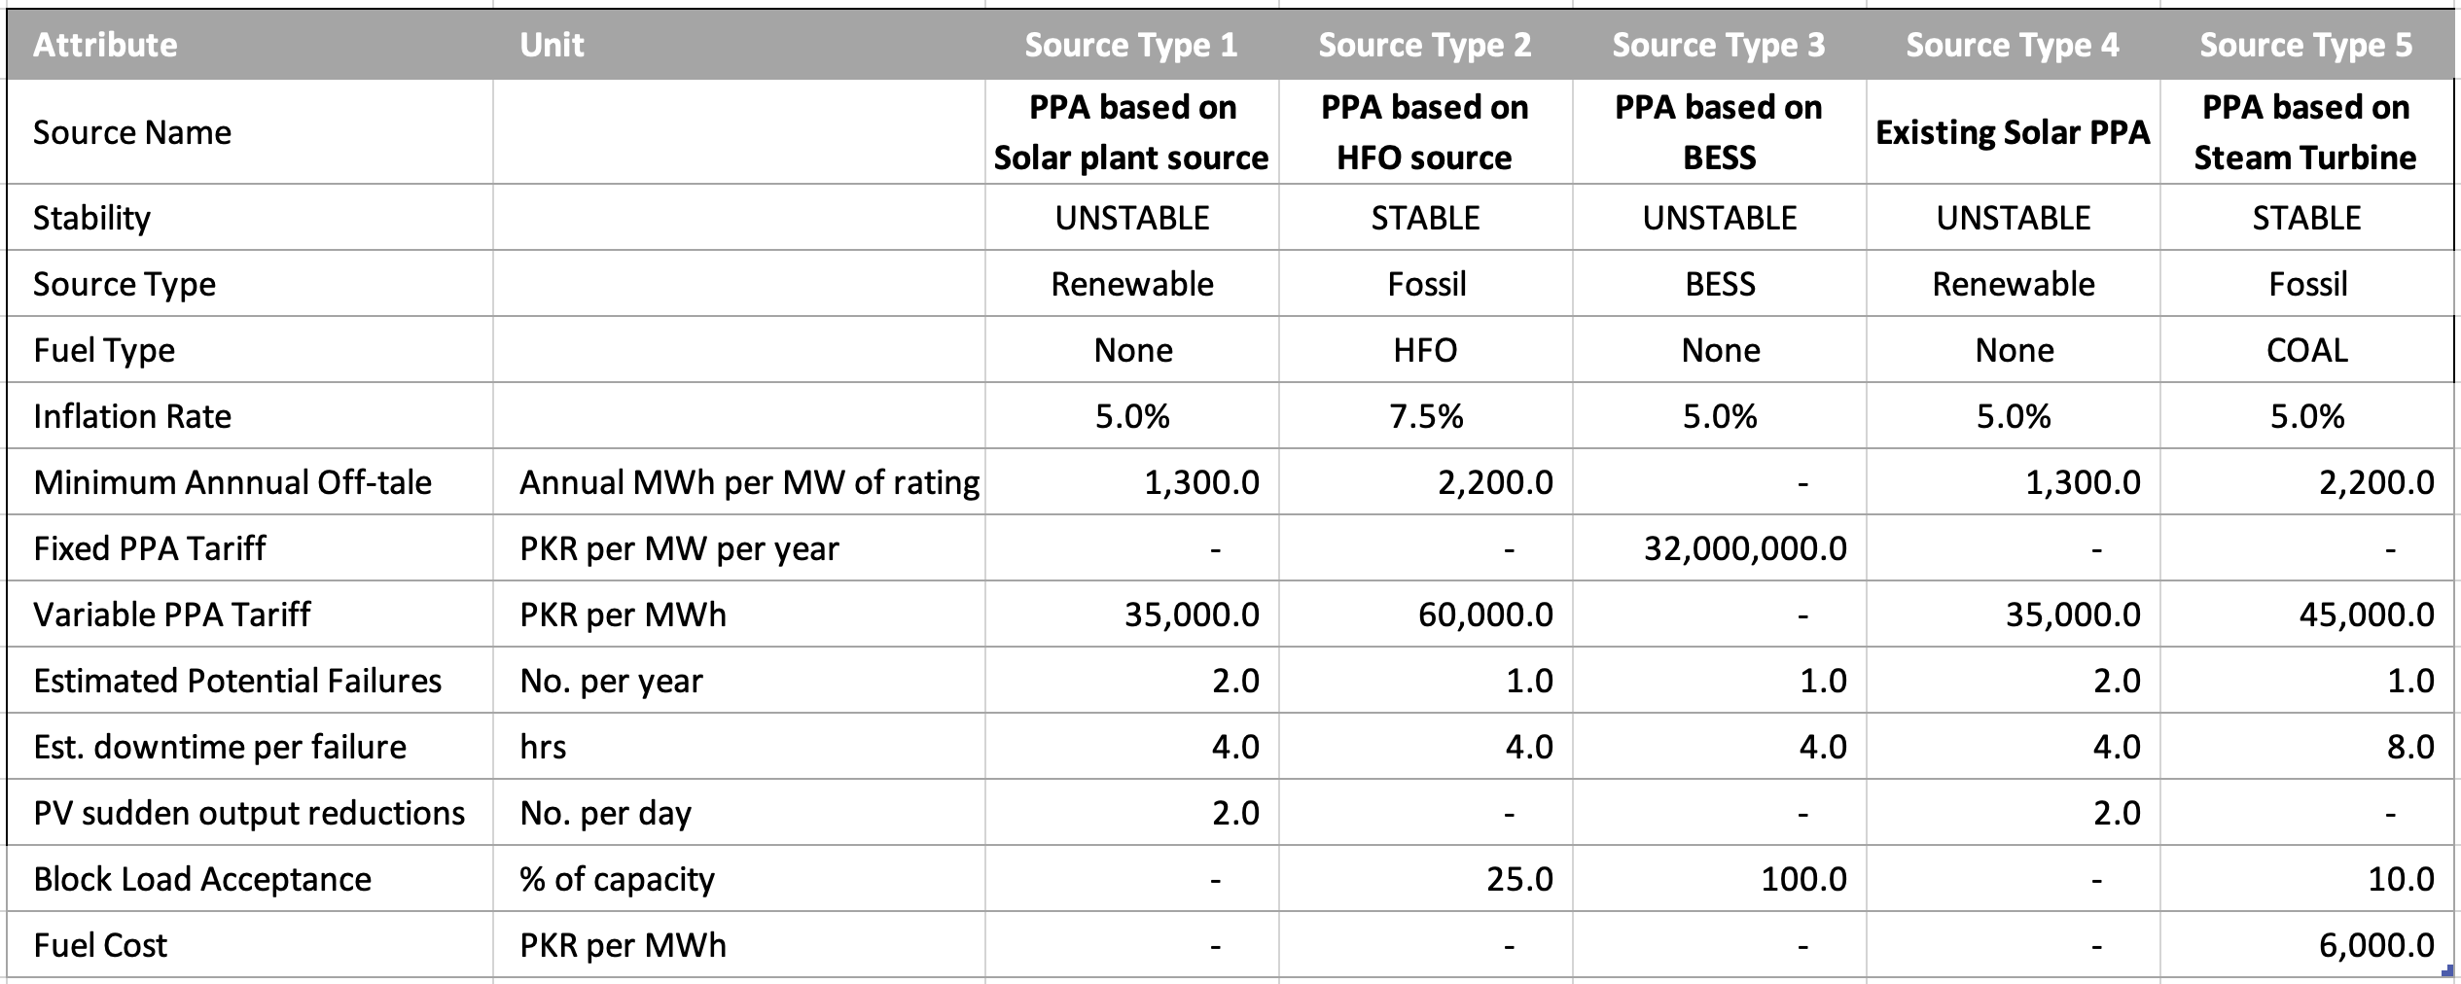
Source Details (PPA Sources)

Slide 11
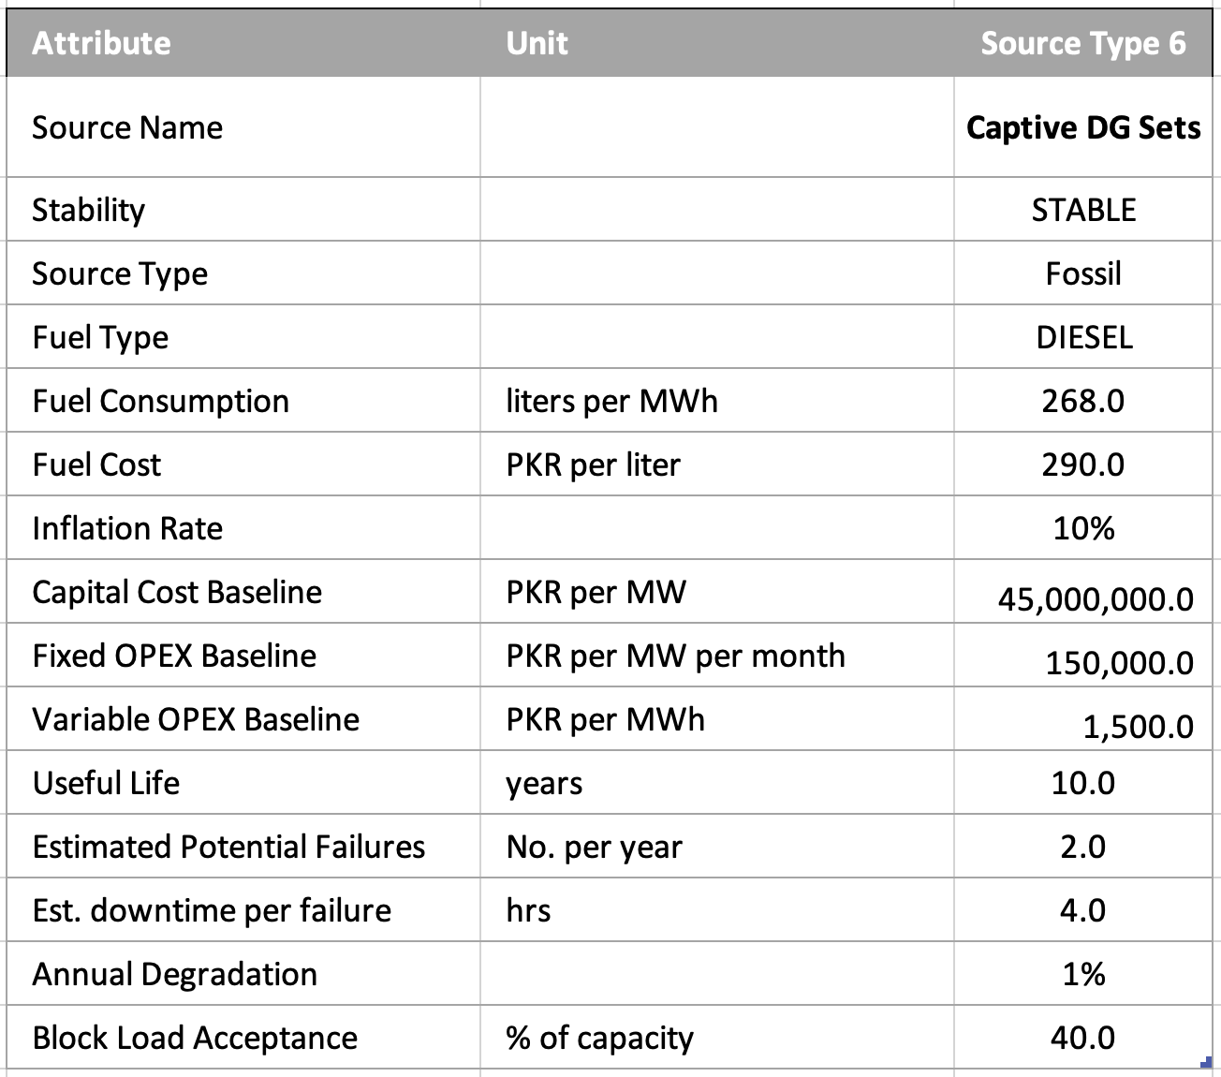
Source Details (Captive Source)

Slide 12
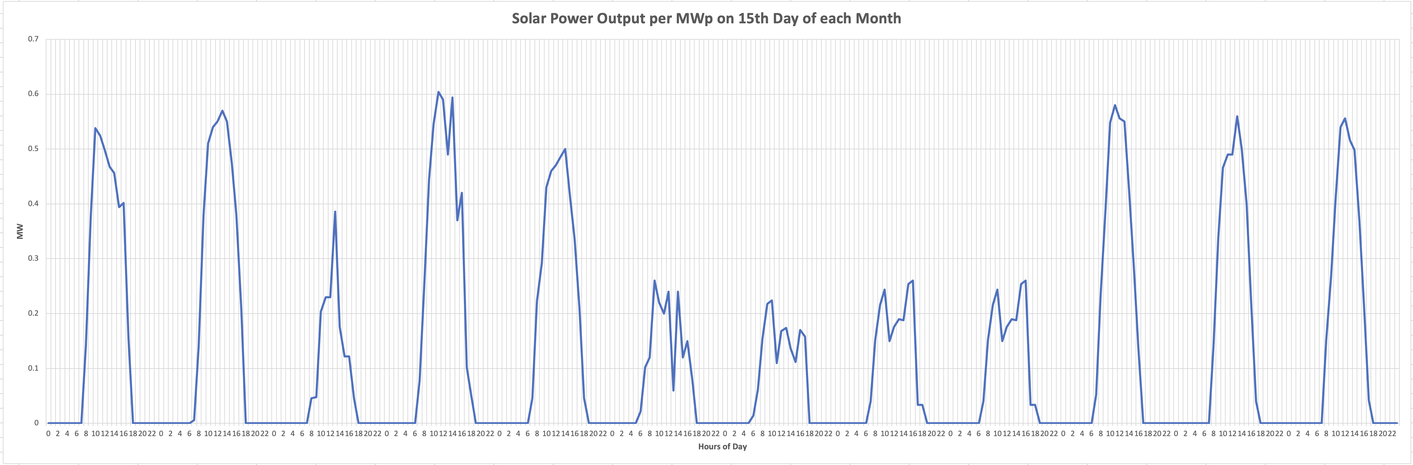
PV Generation Trend

Slide 13
Modeling Algorithm, Evaluation and Results

Slide 14
Model Algorithm/ Approach
Consider hourly power demand
Try to meet demand with least number of highest priority sources
Once met add spinning reserve required for each source type
Simulate probabilistic source failures
Check if operational sources can meet sudden deficit within 4 seconds
Shed non-critical load, if required, record outcomes
Repeat for each hour in day in month, in years (12)
Aggregate technical and commercial data
Input Load, Solar Profile and Source Configuration
Calculate Evaluation Metrics
Start
End

Slide 15
Scenario Evaluation Metrics
1. Energy Fulfilment Ratio (%):
Calculated for each year and as a single metric
Number of hours in which power sources meet energy requirements without load shedding / total number of hours
Must be 99-100% for scenario to be viable
2. Critical Load Interruptions (No.):
Calculated for each year and as a single metric
Number of times critical load is interrupted due to source failures (and inadequate spinning reserve) despite non-critical load shedding
3. Unit Cost (PKR/ kWh):
Calculated for each year, each source and as a single metric

Slide 16
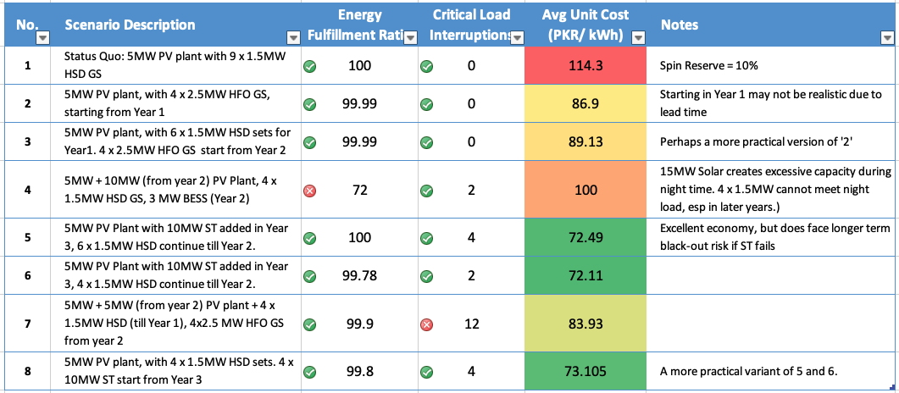
Scenario Results

Slide 17
Recommendations
As shown in scenarios 5 and 6, utilizing a steam turbine based PPA arrangement yields the best results in terms of unit cost.
These options do carry load interruption risk in case of ST fault and outage. Due to the nature of ST operations, this can result in longer term downtime than mine operations permit.
In this context, we believe that option 8, which retains some HSD throughout the study period and in parallel with 5MW PV and 10MW ST, provides a good mix of reliability and relative economy.

Slide 18

Thank you!

